Slide 1
Chapter 3:
The Project Management Process Groups
Information Technology Project Management
Note: See the text itself for full citations.

Slide 2
Learning Objectives / Contents
The five project management process groups
The project management knowledge areas

Slide 3
https://youtu.be/9tIyUwIVRV4
إدارة مشاريع نظم المعلومات MISY303 – YouTube
https://youtu.be/UluNhfCZOME
Notes:
https://youtu.be/845Rm6pGjqY

Slide 4
Project Management Process Groups
INITIATING
Define Authorize
CLOSING
PLANNING
MONITORING
& CONTROLLING
EXECUTING
Track
Review

Slide 5
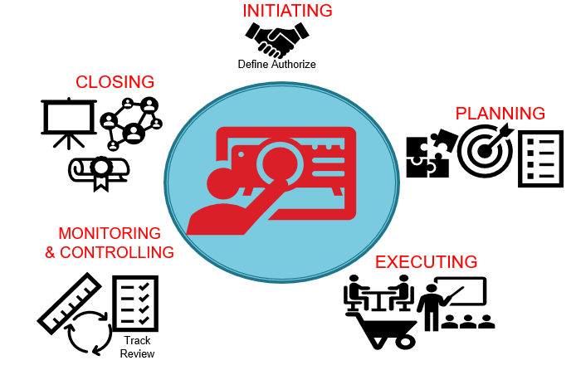
Project Management Process Groups: Outputs
Project Charter
Stakeholder Register
Stakeholder Management Strategy
Lesson Learnt
Final Project Report
Project Management Plan
>>Team Contract
>> List of Prioritized Risks
Performance Report
Change Request
Milestone Reports

Slide 6
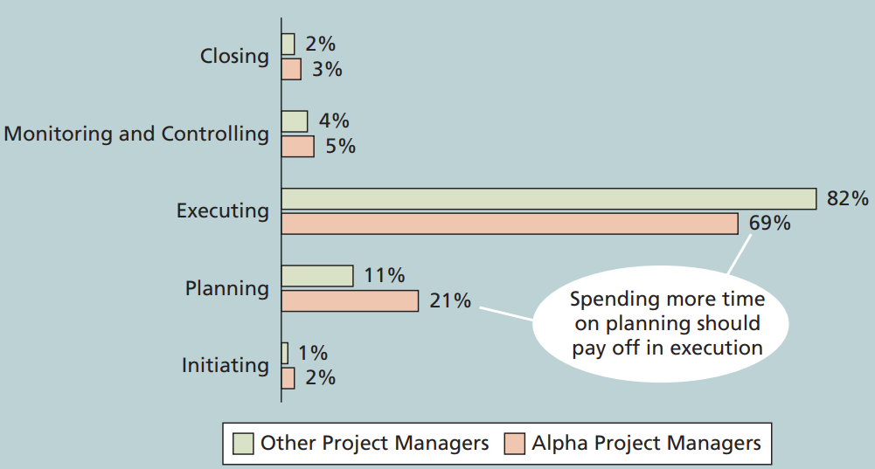
Percentage of Time Spent on Each Process Group

Slide 7
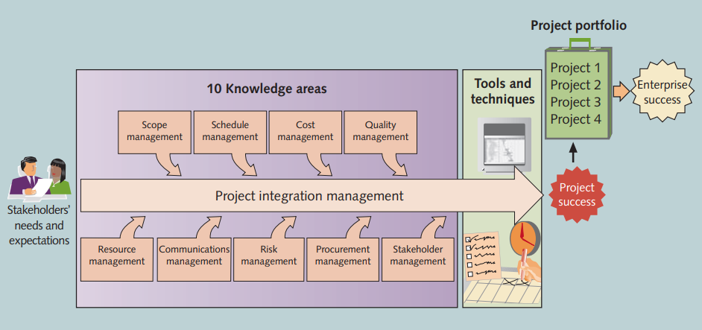
Mapping the Process Groups to the Knowledge Areas
Note that there are activities from each knowledge area under the planning process groups

Slide 8
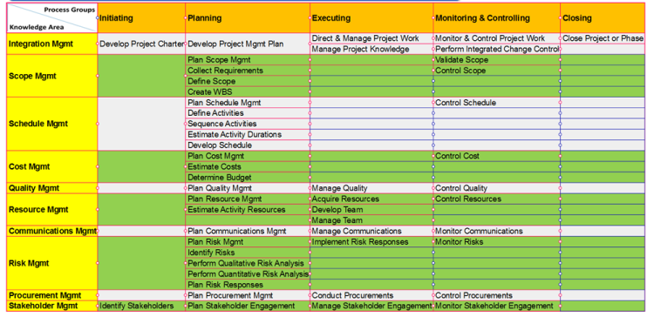
Project Management Process Groups and Knowledge Areas Mapping
“Initiating” process group = 2 processes
“Planning” process group = 24 processes
“Executing” process group = 10 processes
“Monitoring and controlling” process groups = 12 processes
“Closing” process group = 1 process

Slide 9
Case Study: JWD Consulting’s Project Management Intranet Site
This case study provides an example of what’s involved in initiating, planning, executing, controlling, and closing an IT project
Note: This case study provides a big picture view of managing a project. Later chapters provide detailed information on each knowledge area
Notes:
JWD for Job Well Done Consulting
You can download templates for creating your own project management documents from the companion Web site for this text or the author’s site

Slide 10
1- Project Initiation
Initiating a project includes recognizing and starting a new project or project phase
The main goal is to formally select and start off projects
Knowledge area | Initiating Process | Outputs
Project Integration Management | Develop project charter | Project charter
Project Stakeholder Management | Identify stakeholders | Stakeholder register

Slide 11
Project Charter
A Project Charter is a formal document that authorizes a project, outlines its objectives, scope, stakeholders, and key deliverables, and provides a high-level overview of how the project will be executed. It serves as a reference throughout the project lifecycle.

Slide 12
Project Charters and Kick-off Meetings
Charters are normally short and include key project information and stakeholder signatures
It’s good practice to hold a kick-off meeting at the beginning of a project so that stakeholders can meet each other, review the goals of the project, and discuss future plans.

Slide 13
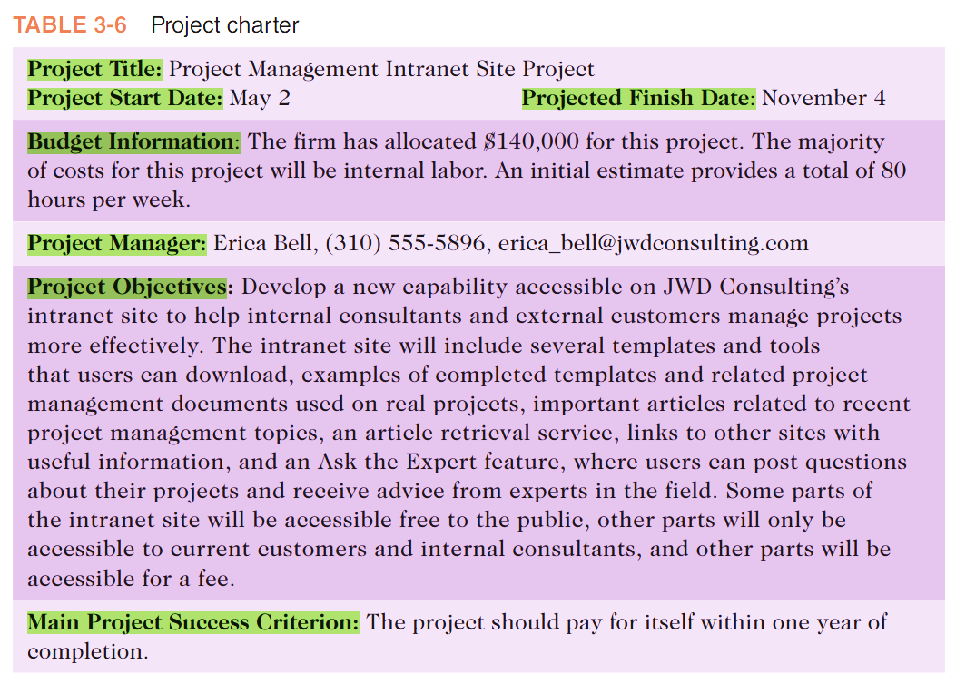

Slide 14
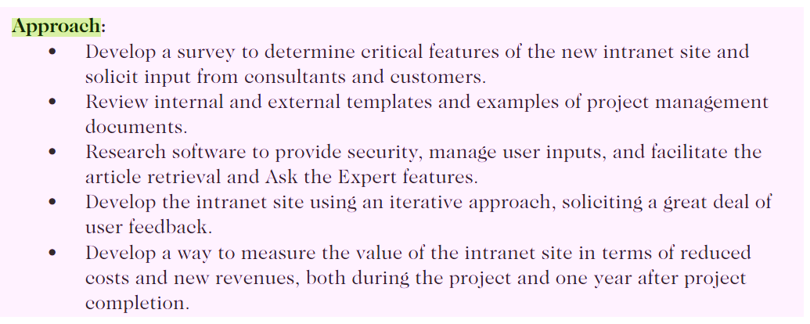
https://everhour.com/blog/project-charter/

Slide 15
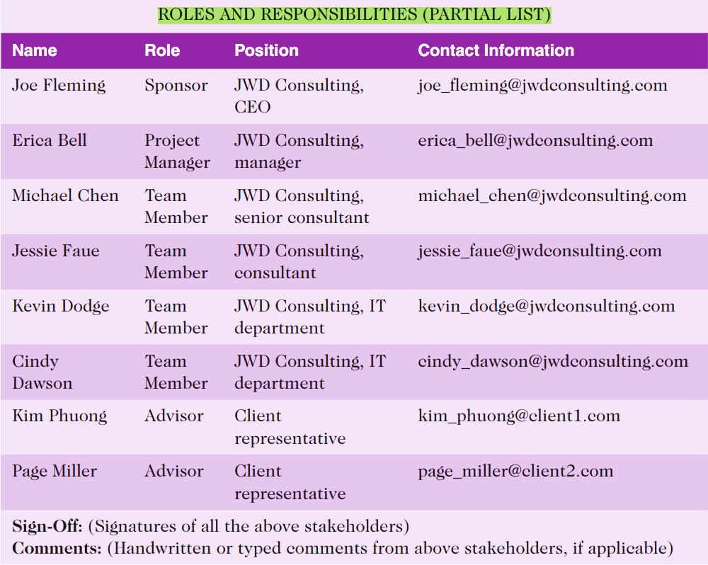

Slide 16
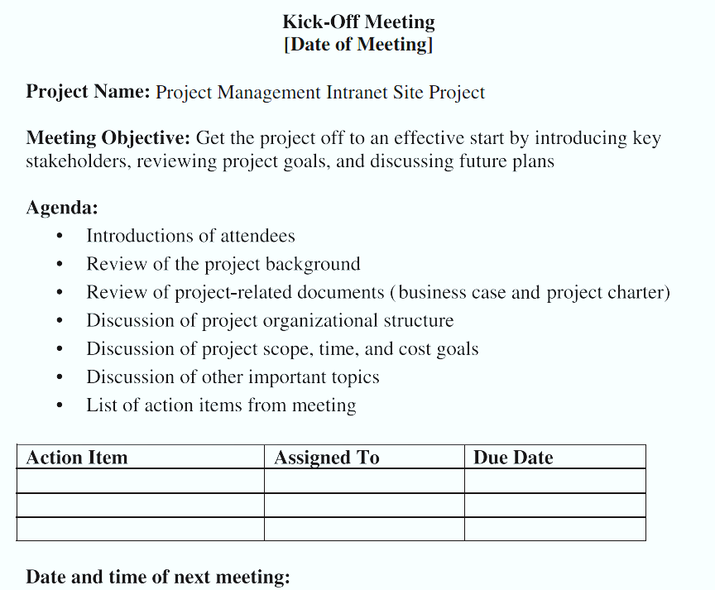
Project Kick-Off Meeting

Slide 17
2- Project Planning
The main purpose of project planning is to guide execution
Every knowledge area includes planning information
Key outputs included in the project include:
  A team contract
  A project scope statement
  A work breakdown structure (WBS)
  A project schedule, in the form of a Gantt chart
  A list of prioritized risks (part of a risk register)

Slide 18
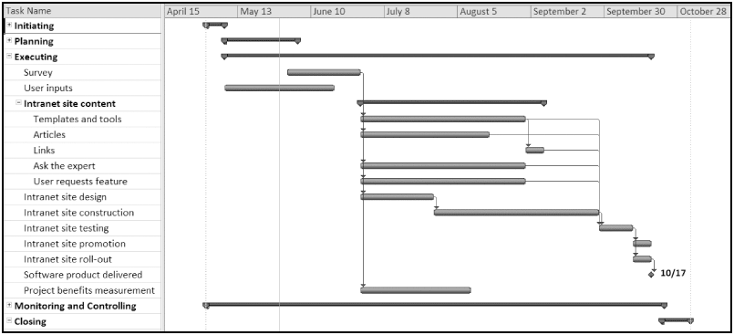
Figure 3-4. JWD Consulting Intranet Site Project Baseline Gantt Chart

Slide 19
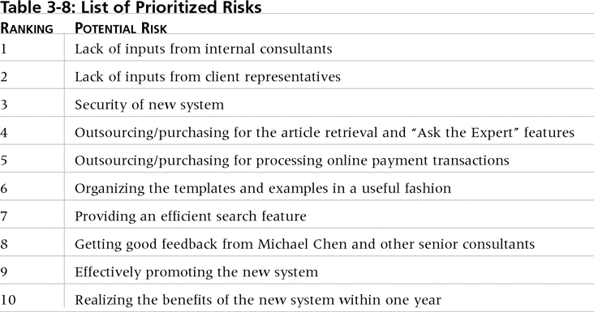
Table. 3-10. List of Prioritized Risks

Slide 20
3- Project Executing
Usually takes the most time and resources to perform project execution
Project managers must use their leadership skills to handle the many challenges that occur during project execution
Many project sponsors and customers focus on deliverables related to providing the products, services, or results desired from the project
A milestone report can help focus on completing major milestones

Slide 21
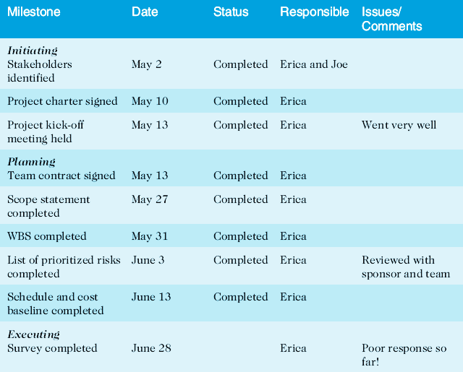
Part of Milestone Report

Slide 22
4- Project Monitoring and Controlling
Involves measuring progress toward project objectives, monitoring deviation from the plan, and taking correction actions
Outputs include performance reports, change requests, and updates to various plans

Slide 23
5- Project Closing
Involves gaining stakeholder and customer acceptance of the final products and services
Even if projects are not completed, they should be closed out to learn from the past
Outputs include project files and lessons-learned reports, part of organizational process assets
Most projects also include a final report and presentation to the sponsor/senior management

Slide 24
Chapter Summary
The five project management process groups are initiating, planning, executing, monitoring and controlling, and closing
The JWD Consulting case study provides an example of using the process groups and shows several important project documents

Slide 25
Questions
Describe the five process groups
What are some of the key outputs of each process group?

